Slide 1
How Recent Events Are Changing The HVAC Industry
REGULATORY | Influence Major Industry Changes Being Decided in 2022
7:30 – 7:40 am WELCOME
Patricia Rothwell, Common Thread, LLC • EEBC, Executive Director
7:45 – 8:15 am HOW RECENT EVENTS ARE CHANGING THE HVAC INDUSTRY
PRESENTATIONS | “The Intersection of Sustainability, IAQ, & Emerging Trends/Technology”
Trane Technologies • Kandice Cohen, Director Electrification of Heat, Commercial HVAC
Mitsubishi Electric Trane HVAC • Sam Beason, Sr. Manager of Utilities and Electrification
Daikin North America/The Heat Pump Store • Jonathan Moscatello, Business Development Manager Southwest
Carrier West • Roger Yannett, Territory Manager / Residential New Construction Specialist
8:20 – 8:40 am | PANEL DISCUSSION & Q&A
8:45 – 9:15 am UPDATE | LOCAL REGULATORY & LEGISLATIVE SESSION | EEBC PRIORITIES IN 2022
Howard Geller, EEBC Consultant
• Model Codes Bill Introduction
Christine Brinker, Senior Buildings Policy Manager • SWEEP • Legislative Bills
Justin Brant, Utility Program Co-Director • SWEEP
• 2023 DSM & 2024-25 DSM [Rebate] Plan, Xcel Energy
• Strategic Issues, Xcel Energy - Goal Setting Influencing Rebate [DSM] Programs For Next 5 Years & Beyond
9:20 – 9:25 am POLICY ACTION COMMITTEE [PAC] & INDUSTRY ACTION GROUPS | JOIN
PAC CHAIR • Carmen Best, VP of Policy & Emerging Markets, Recurve
LIGHTING CO-CHAIRS • Mike Bryant, Nuova Luce, LLC & Scot Kelley, Colorado Lighting HVAC/HP CO-CHAIRS • Shawn LeMons, Mitsubishi & Pete Perrett, GA Larson
SOLAR DECATHLON • EE House Sponsorship Opportunity • Student Invitation Presentation
9:30 am MEETING CONCLUSION
REMINDER | QMM | JUNE 16, 2022

Slide 2
WELCOME

Slide 3
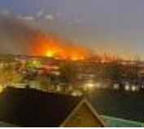
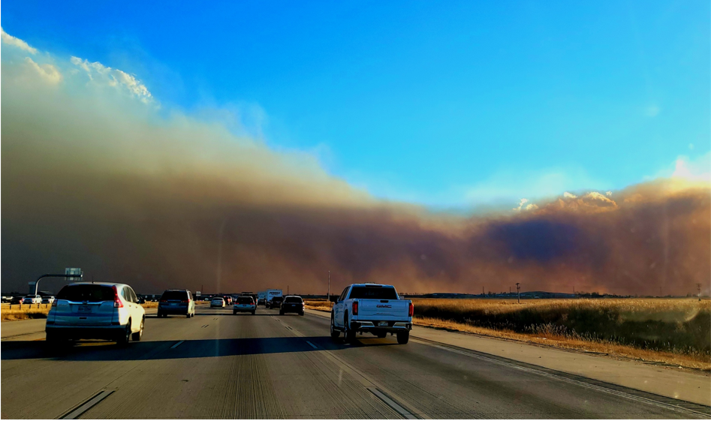
How Recent Events Are Changing The HVAC Industry COVID-19 • Wildfires • Emerging Trends & Tech

Slide 4
PANEL DISCUSSION
Kandice Cohen, Dir. Electrification of Heat, Commercial HVAC
Trane Technologies
Sam Beason, Sr. Manager of Utilities and Electrification
Mitsubishi Electric Trane HVAC
Jonathan Moscatello, Business Development Manager SW/
The Heat Pump Store, Daikin North America
Roger Yannett, Territory Manager/Residential New Construction Specialist, Carrier West

