Slide 1
Commercial Heat Pump Incentives
2024 Updates
Streamline and align requirements
Increase rebate amounts
Add Equity Priority Building designation
Additional information and rebates at PACEpartners.com

Slide 2
Commercial Heat Pump Incentives
Technology | Standard Rebate | EPB Rebate
Ground Source Heat Pump | $2,000 / ton | $4,000 / ton
Cold Climate Air Source Heat Pump or VRF | $1,500 / ton | $3,000 / ton
All-Electric or Dual Fuel RTU | $1,500 / ton | $3,000 / ton
Non-Cold Climate Air Source Heat Pump | $750 / ton | $1,500 / ton
Electrification Feasibility Studies | Up to $20,000 80% of cost | Up to $20,000 100% of cost
Electric Infrastructure Upgrades | Up to $4,000 80% of cost | Up to $4,000 100% of cost
Additional information and rebates at PACEpartners.com

Slide 3
Residential 2024 Rebate Updates & Upcoming Changes
Current Changes:
Simplified air source heat pump & mini-split heat pump rebate requirements
Now offering rebates for electric panel upgrades, air-to-water heat pumps, and heat pump dryers
Upcoming Changes:
Streamlined digital rebate applications
Ability for the contractor to claim the rebate, if customer approved
New, larger moderate-income rebates
Additional information and rebates at energysmartyes.com
Notes:
Unbiased resource to residents looking to improve home comfort, efficiency, and carbon footprint - We help residents navigate the complex and sometimes hard-to-understand landscape of efficiency, contractors, and rebates/incentives

Slide 4
Residential Electrification Incentives
Technology | Boulder County Rebate | City of Boulder Rebate | City of Louisville Rebate
Air Source/Mini-Split Heat Pump | Up to $300 | Up to $400 | Up to $400
Ground Source Heat Pump | Up to $400 | Up to $650 | Up to $650
Air to Water Heat Pump | Up to $300 | Up to $400 | N/A
Heat Pump Water Heater | Up to $100 | Up to $250 | Up to $250
Electric Panel Upgrade | Up to $100 | Up to $250 | Up to $250
Heat Pump Dryer | Up to $100 | Up to $250 | N/A
Induction Cooktop (replacing gas) | Up to $100 | Up to $200 | Up to $150
*Additional rebates may be available if replacing gas systems - Engagement with EnergySmart required before project completion
Additional information and rebates at energysmartyes.com
Notes:
Unbiased resource to residents looking to improve home comfort, efficiency, and carbon footprint - We help residents navigate the complex and sometimes hard-to-understand landscape of efficiency, contractors, and rebates/incentives

Slide 5
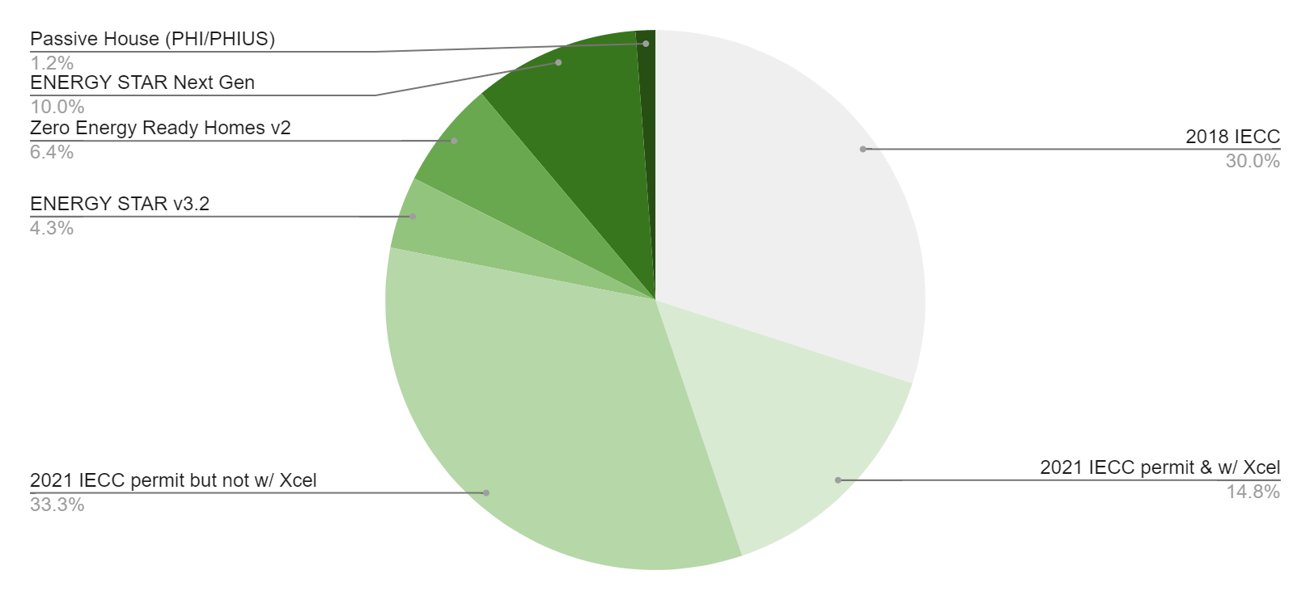
Marshall Fire Rebuild Update
Notes:
Read chart, note nearly 50% of the homes are above 2018 code (including those that have registered with Xcel and those that have not yet done so) and that at least 11% are all electric.

Slide 6
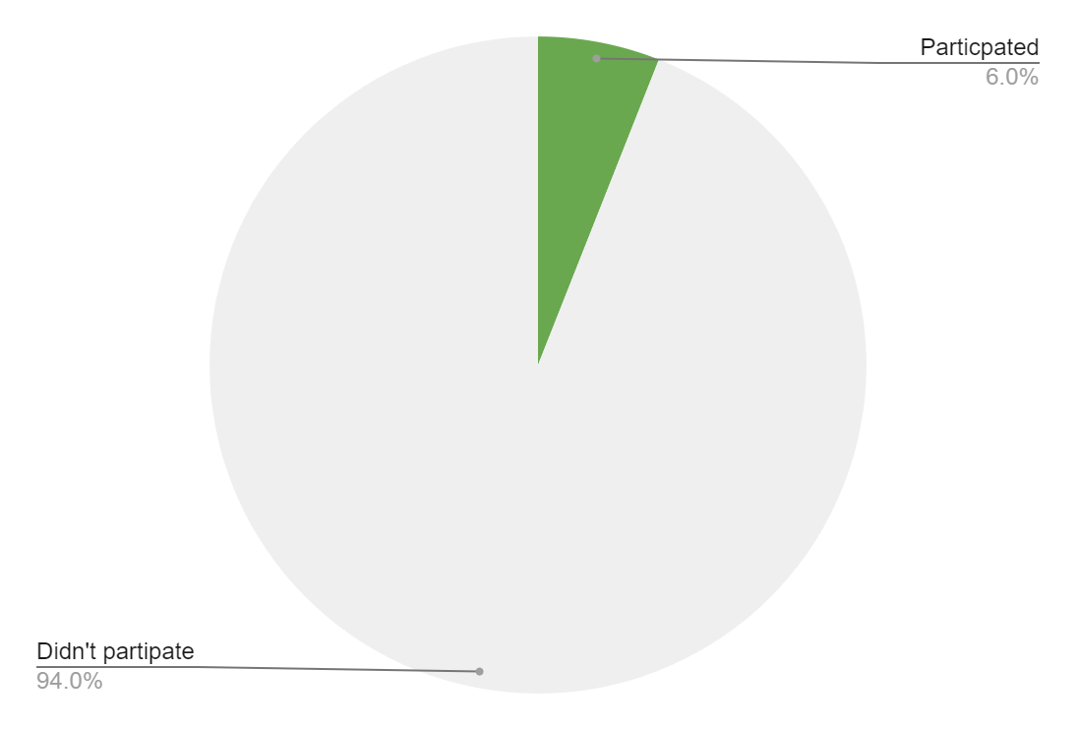
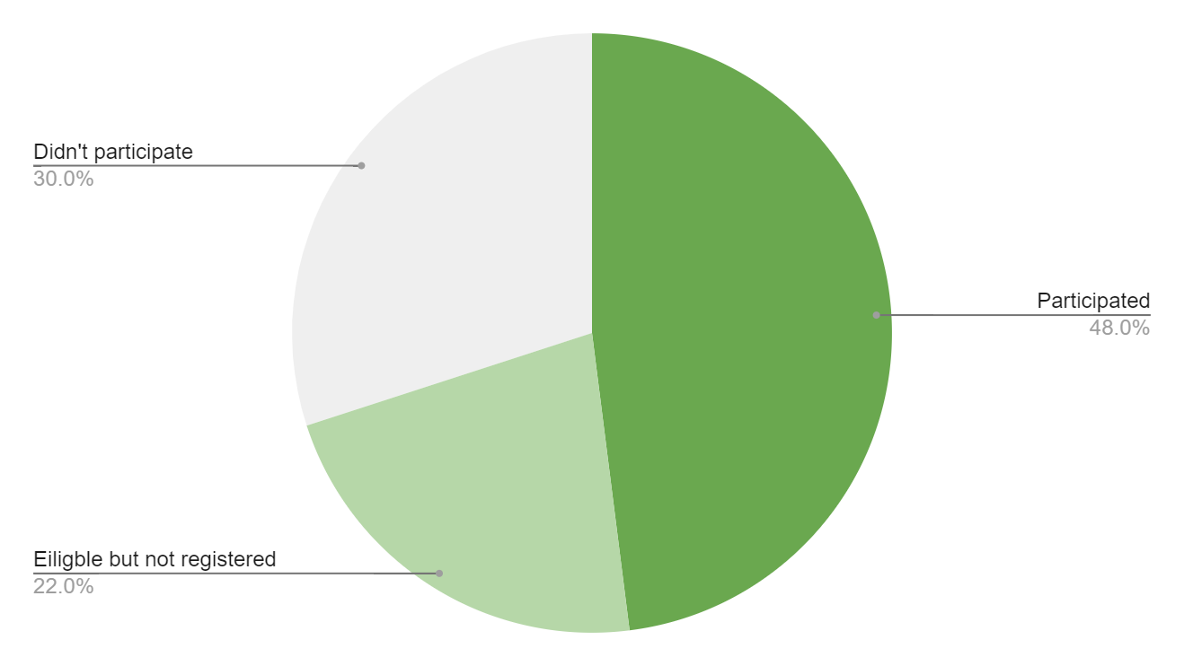
Marshall Fire Rebuild Update
Tubbs Fire Advanced Energy Rebuild
Marshall Fire Rebuilding Better
Notes:
Compare our results to a similar effort after the Tubbs Fire in Sonoma County. We achieved 10x the participation rate

Slide 7
Marshall Fire Rebuild Update
Good news!
Our homeowner education and incentives worked!
Builders and HVAC companies tried all electric construction for the first time
Bad news ☹!
Install quality issues
Non cold climate heat pumps with no back up
Oversized heat pumps
Heat pump water heaters with recirculating pumps
Heat pumps getting taken out and replaced with furnaces already
Untrained and unhappy homeowners with high electric bills
Some builders have sworn off all electric construction
Notes:
What went wrong? Despite clear program requirements and a free advising service for homeowners, builders, and contractors, we failed to anticipate the apparent need for greater education of the building trades on how to properly choose equipment that will meet the home’s needs and install it correctly.

