Slide 1
City and County of Denver
Home Energy Rebates
Notes:
Intro
Ask who participated

Slide 2
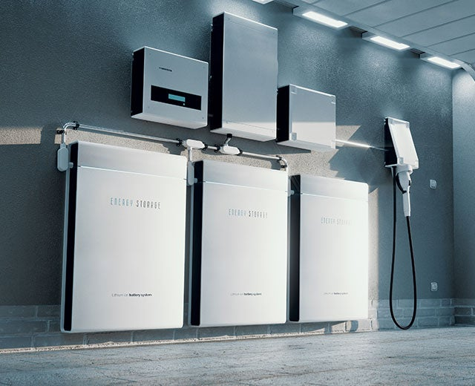
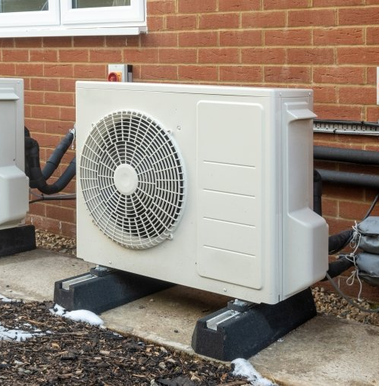


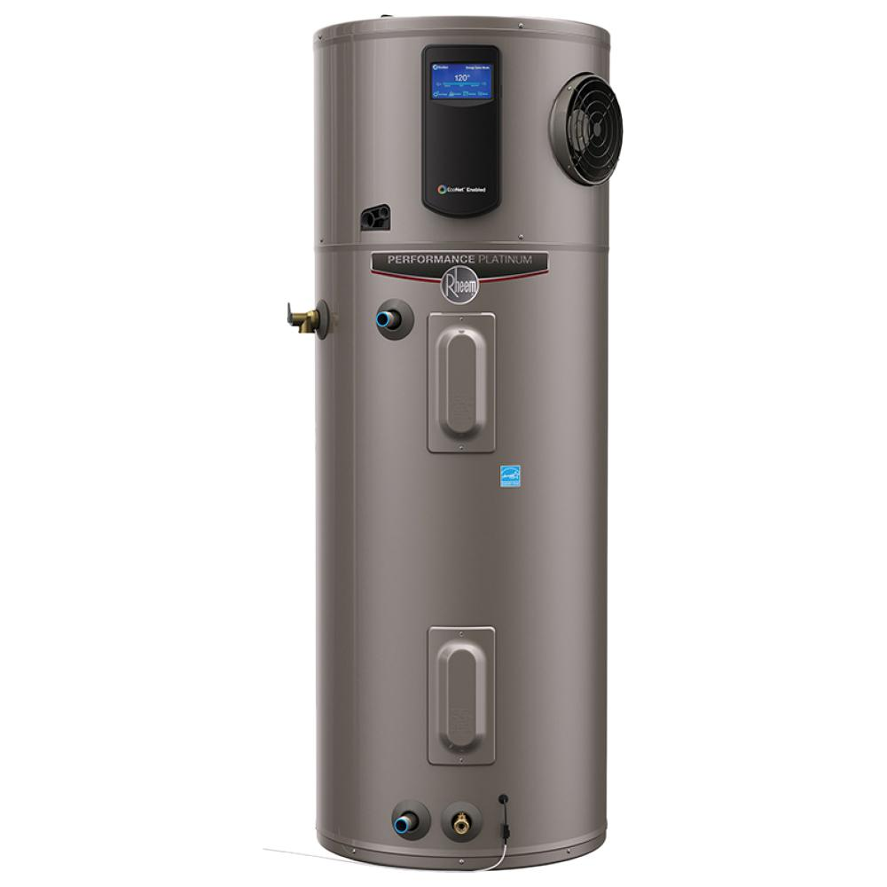
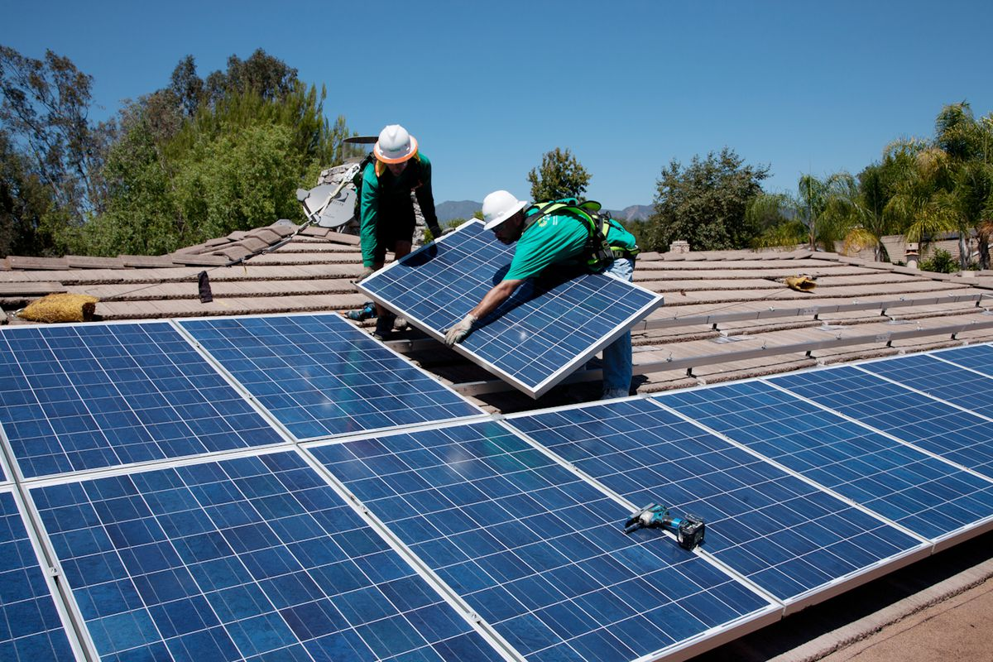
Eligible Products
Home Energy
Heat Pumps for Heating and Cooling
Heat Pump Water Heaters
Rooftop Solar
Battery Storage
EV’s
Electrical Service
(Ebikes)
Notes:
These are all part of the program
Today we’re focused on heat pumps

Slide 3
Denver Home Energy Rebates – 2022 Updates
Updated Portal and Application with Reservations
  https://denverhomeenergy.powerappsportals.com/ - Installer Portal
  https://bit.ly/CAREContractorResources - Program Resources for Installers and Contractors
  www.denvergov.org/homeenergy - Program Links and Homeowner resources
Updated Rebate Amounts
Updated Performance Requirements
Thank you!
Notes:
We heard the feedback – this year forward we will be clear, consistent and available.
Some changes include:
Updated installers portal with Spanish and multilanguage ability. Still point of sale rebates w/ reimbursement. Added the ability to reserve all rebates when uploading a contract. You know these will be there when the job is completed.
Resources for homeowners about heat pumps and incentives (feel free to refer customers to these if useful)
Updated rebate amounts – lowered from 2022 in order to reach more customers and stay available longer
Updated performance reqs. Non-cold climate matches Xcel, cold-climate has shifted to slightly less stringent performance. Details on our website above
Thank you for the feedback. Continue the feedback

Slide 4
Home Energy Rebates – 2023 Rebate Amounts
Notes:
As mentioned – rebate amounts are lowered from last year, but still very generous. Balanced with new tax incentives via Inflation Reduction Act

Slide 5
Home Energy Rebates – 2023 Rebate Amounts
Notes:
We are on track to keep rebates open this year and next.

Slide 6
City and County of Denver:
Mac Prather, Residential Electrification Programs mac.prather@denvergov.org
ClimateActionRebates@denvergov.org
DenverRebateLogins@aptim.com
Notes:
Reach out to an of these.

Slide 7
City and County of Denver
Building Electrification Incentives
Commercial and Multifamily
Notes:
Intro
Ask who participated

Slide 8
Permit Process and Equipment Replacement
Regulation Summary
March 2023
January 2025
January 2027
Permit process: Changes to near parity in permitting between unitary AC/condensing units serving a heated space, gas furnaces, gas hot water heaters and heat pumps.
Equipment replacement: Heat pumps required upon replacement of unitary AC/condensing units serving a heated space, gas furnaces, gas hot water heaters when cost-effective.
Permit process: Changes to near parity in permitting between PTACs, boilers, central hot water systems and heat pumps.
Equipment replacement: Heat pumps required upon replacement of PTACs, boilers, central hot water systems when cost-effective.
Notes:
If your HVAC equipment at or near it’s end of useful life, now is a great time to plan for the replacement. There are more efficient systems with lower greenhouse gas emissions available. You can switch completely or partially to a heat pump to heat and cool your building by planning ahead and understanding the options and costs. These are steps that we recommend you take before the building code requires you to make any changes:
Evaluate the feasibility of replacing your equipment with a heat pump through an Electrification Feasibility Report. You will likely need to work with a contractor to complete this report. See a list of contractors(PDF, 100KB) who have completed a training with us about the Electrification Feasibility Report.
Evaluate the incentives, tax credits, and financing options available for your building type and income level.
Decide which equipment is right for your building based on your typical energy use, equipment costs, equipment availability, and funding sources. Your Electrification Feasibility Report should help you decide which choice makes the most sense.

Slide 9

Electrification Feasibility Reports
Tool designed to assess practicality and cost of electrification
One code compliance pathway
3 in person trainings – one more in August
Up to $2,500 for contractors (attend training and passed test)
Online training coming soon
EFR Website

Slide 10
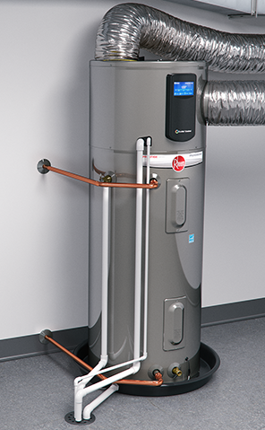
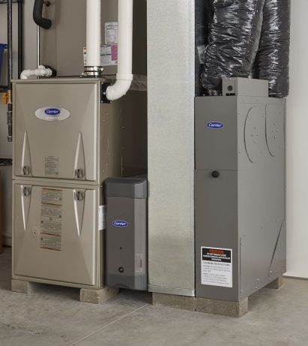
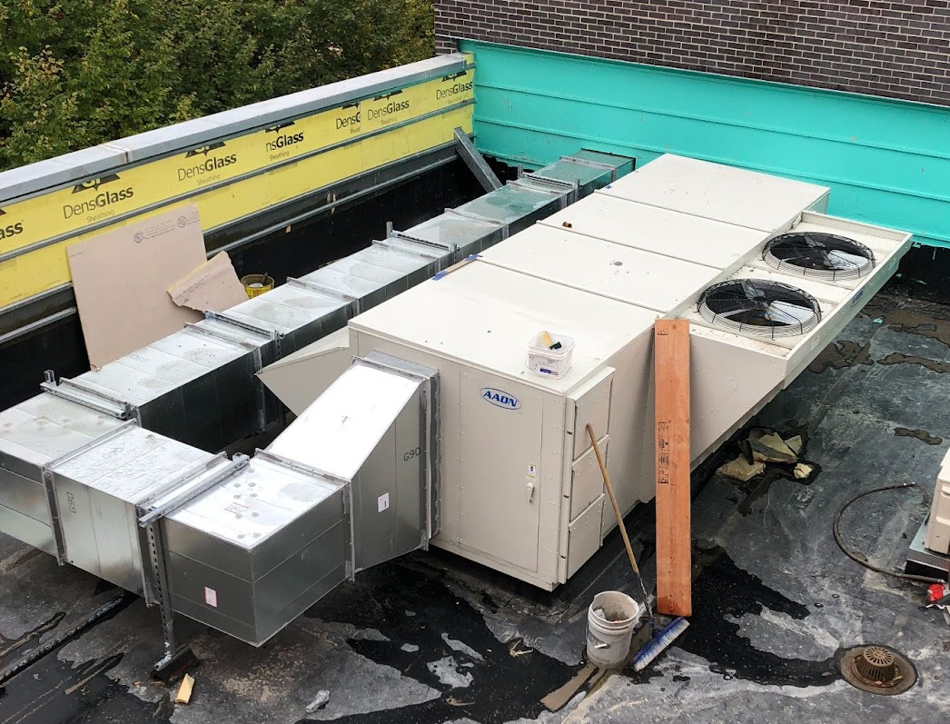
Incentives for Electrification
Incentives starting soon
Cover incremental cost
Parity with single family
Iterative approach
Feedback
Furnaces and Unitary AC
Roof top units
Tank WH
Building Electrification Incentives
Unit Ventilators

Slide 11

For more information on code and permit changes
Visit
Community, Planning and Development
Or Call: 720-865-2720
Or email: planreview@denvergov.org

Slide 12
Contact Information
Jeff Tejral – jeff.tejral@denvergov.org
Sam Lichtin - Samantha.Lichtin@denvergov.org
Program email – electrification@denvergov.org

